Slide 1
MACHINE LEARNING – UNIT – 03: SUPERVISED LEARNING
Supervised learning setup
LMS
Logistic regression
Perceptron
Exponential family

Slide 2
Generative learning algorithms
Gaussian discriminant analysis
Naive Bayes
Support vector machines
Model selection and feature selection
Ensemble methods: Bagging & Boosting
Evaluating and debugging learning algorithms

Slide 3
The fundamental algorithms in data mining and analysis include automated methods to analyze patterns and models for all kinds of data, with applications ranging from scientific discovery to business intelligence and analytics.

Slide 4
Data Mining: The process of discovering:
Insightful, Interesting, and Novel Patterns,
as well as:
Descriptive, Understandable, and Predictive Models
from large-scale data.
Main data mining tasks:
Exploratory Data Analysis
Frequent Pattern Mining
Clustering and Classification

Slide 5
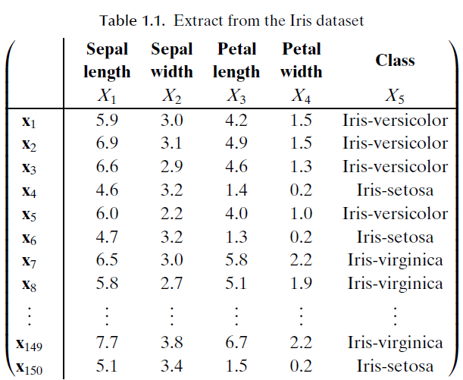

Slide 6
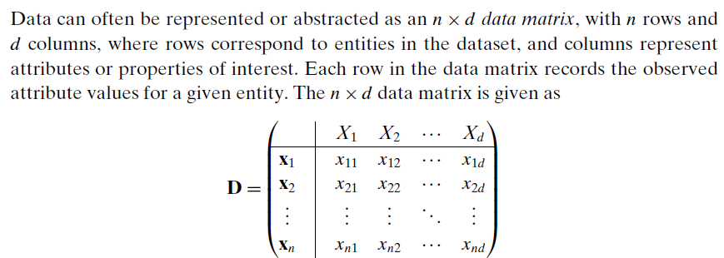
DATA MATRIX

Slide 7
Columns of the matrix are: attributes, properties, features, dimensions, variables, fields, and so on.
Data Size: The number of instances ‘n’
Data Dimensionality: The number of attributes d.
Univariate Analysis: Analysis of a single attribute
Bivariate Analysis: simultaneous analysis of two attributes
Multivariate Analysis: Simultaneous analysis of more than two attributes.

Slide 8
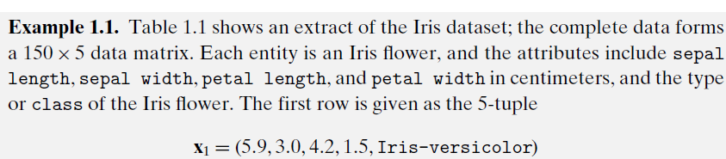

Slide 9
Not all datasets are in the form of a data matrix.
Example: More complex datasets can be in the form of sequences (e.g., DNA and protein sequences), text, time-series, images, audio, video, and so on, which may need special techniques for analysis.
However, in many cases even if the raw data is not a data matrix it can usually be transformed into that form via feature extraction.
Example: Given a database of images, we can create a data matrix in which rows represent images and columns correspond to image features such as color, texture, and so on.

Slide 10
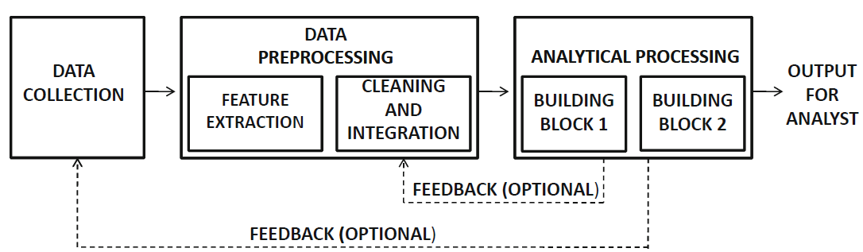
Figure: The data processing pipeline

Slide 11
Data Mining Definition from Gartner group:
“The process of discovering meaningful new correlations, patterns and trends by sifting through large amounts of data stored in repositories, using pattern recognition technologies as well as statistical and mathematical techniques.”
Data mining techniques are facing with lots of difficulties.
These difficulties could be classified in the following parts:
Pre-processing of the data in the wild.
Choice of proper data classification algorithm.
The time-consuming problem.

Slide 12
Drivers:
Market
IT
Dramatic drop in storage costs
Automatic data capture of transactions
Internet, etc.

Slide 13
Core Disciplines:
Statistics
Machine Learning
Database Retrieval &
Parallel Developments

Slide 14
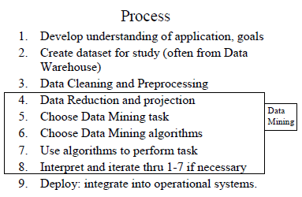
Data Mining Process

Slide 15
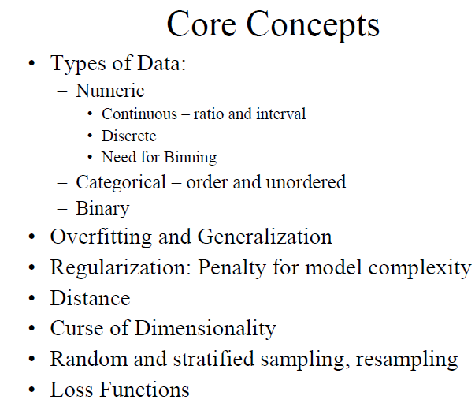

Slide 16
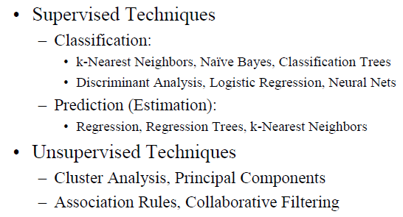

Slide 17
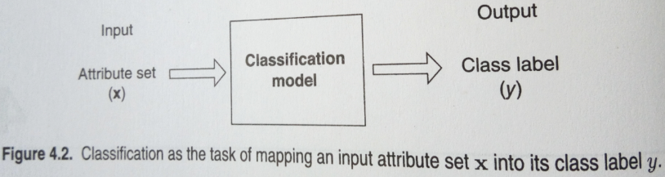

Slide 18
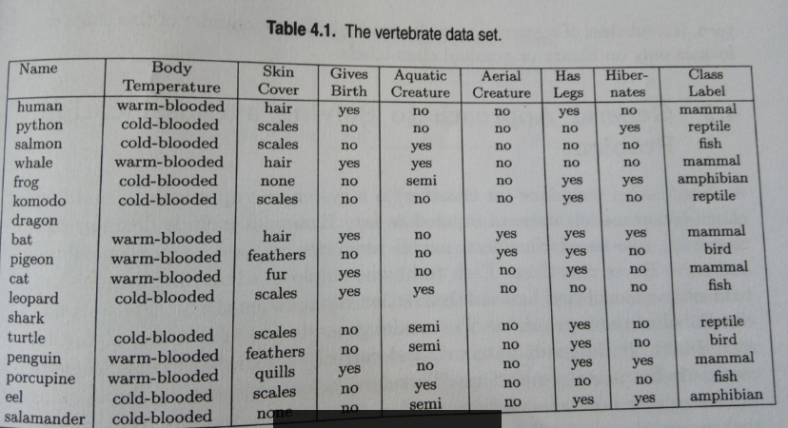

Slide 19
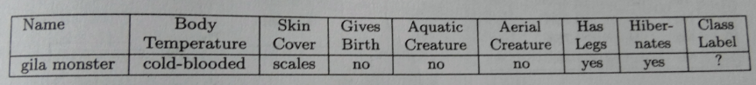
a

Slide 20
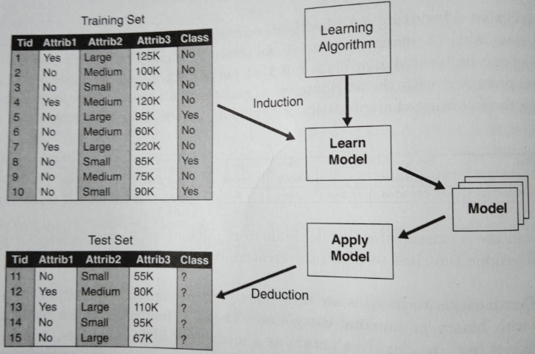
Figure: General Approach for building a Classification Model

Slide 21
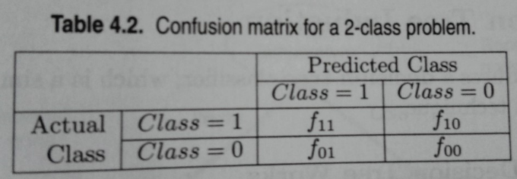

Slide 22
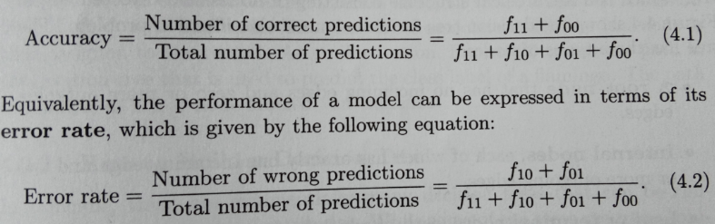

Slide 23
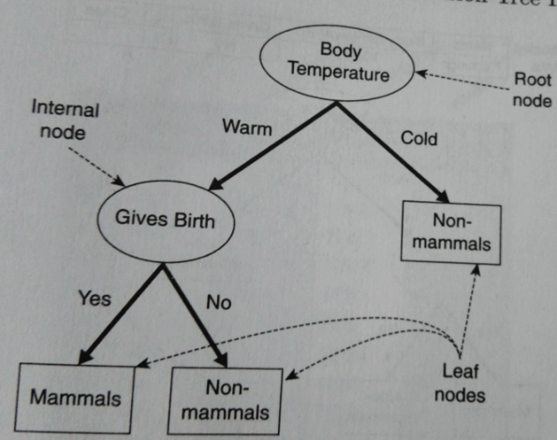
Figure: Decision Tree for Mammal Classification Problem

Slide 24
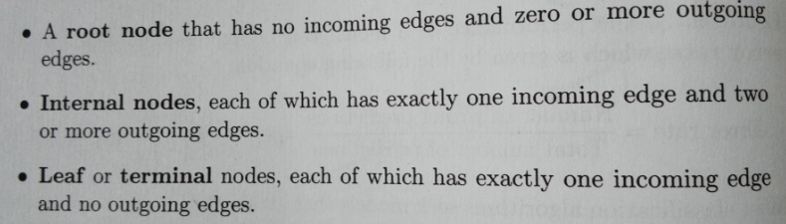

Slide 25
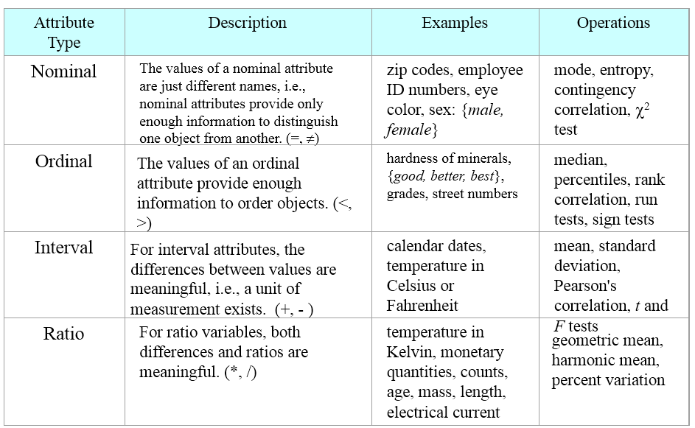

Slide 26
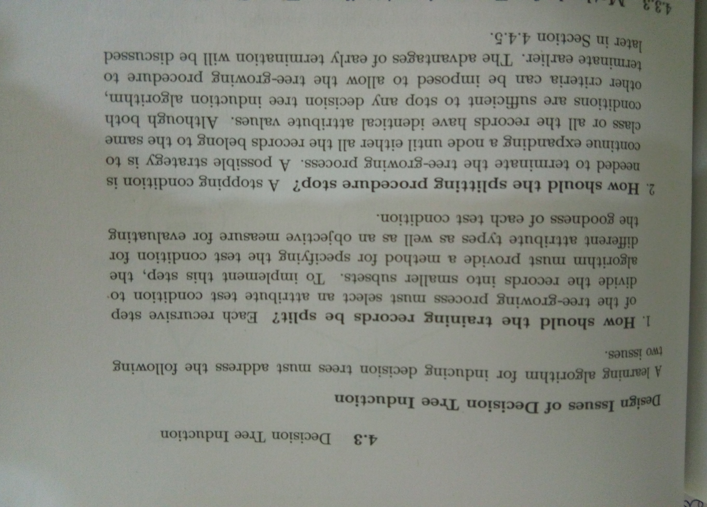

Slide 27
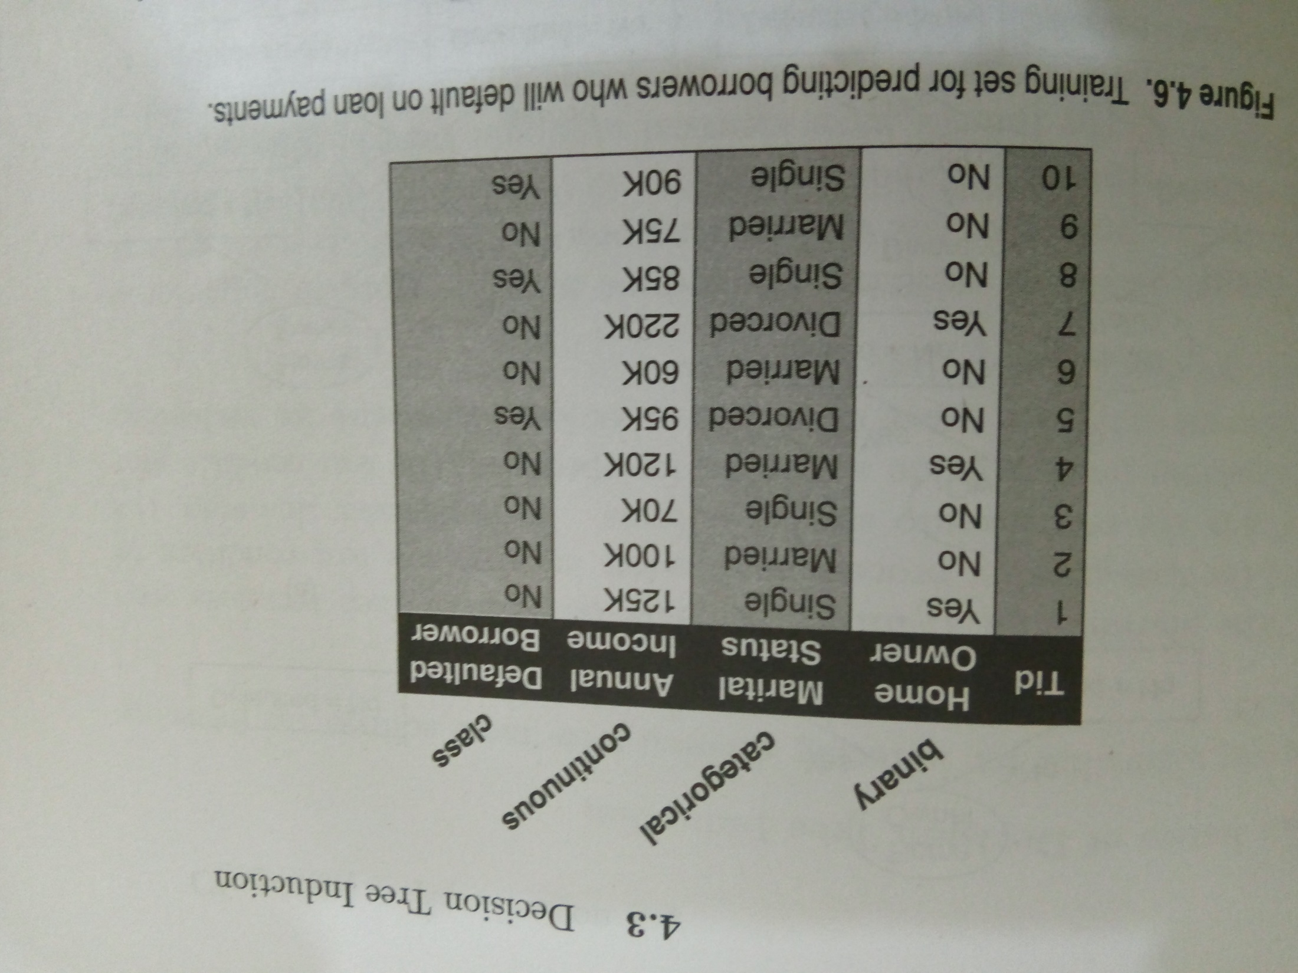
a

Slide 28
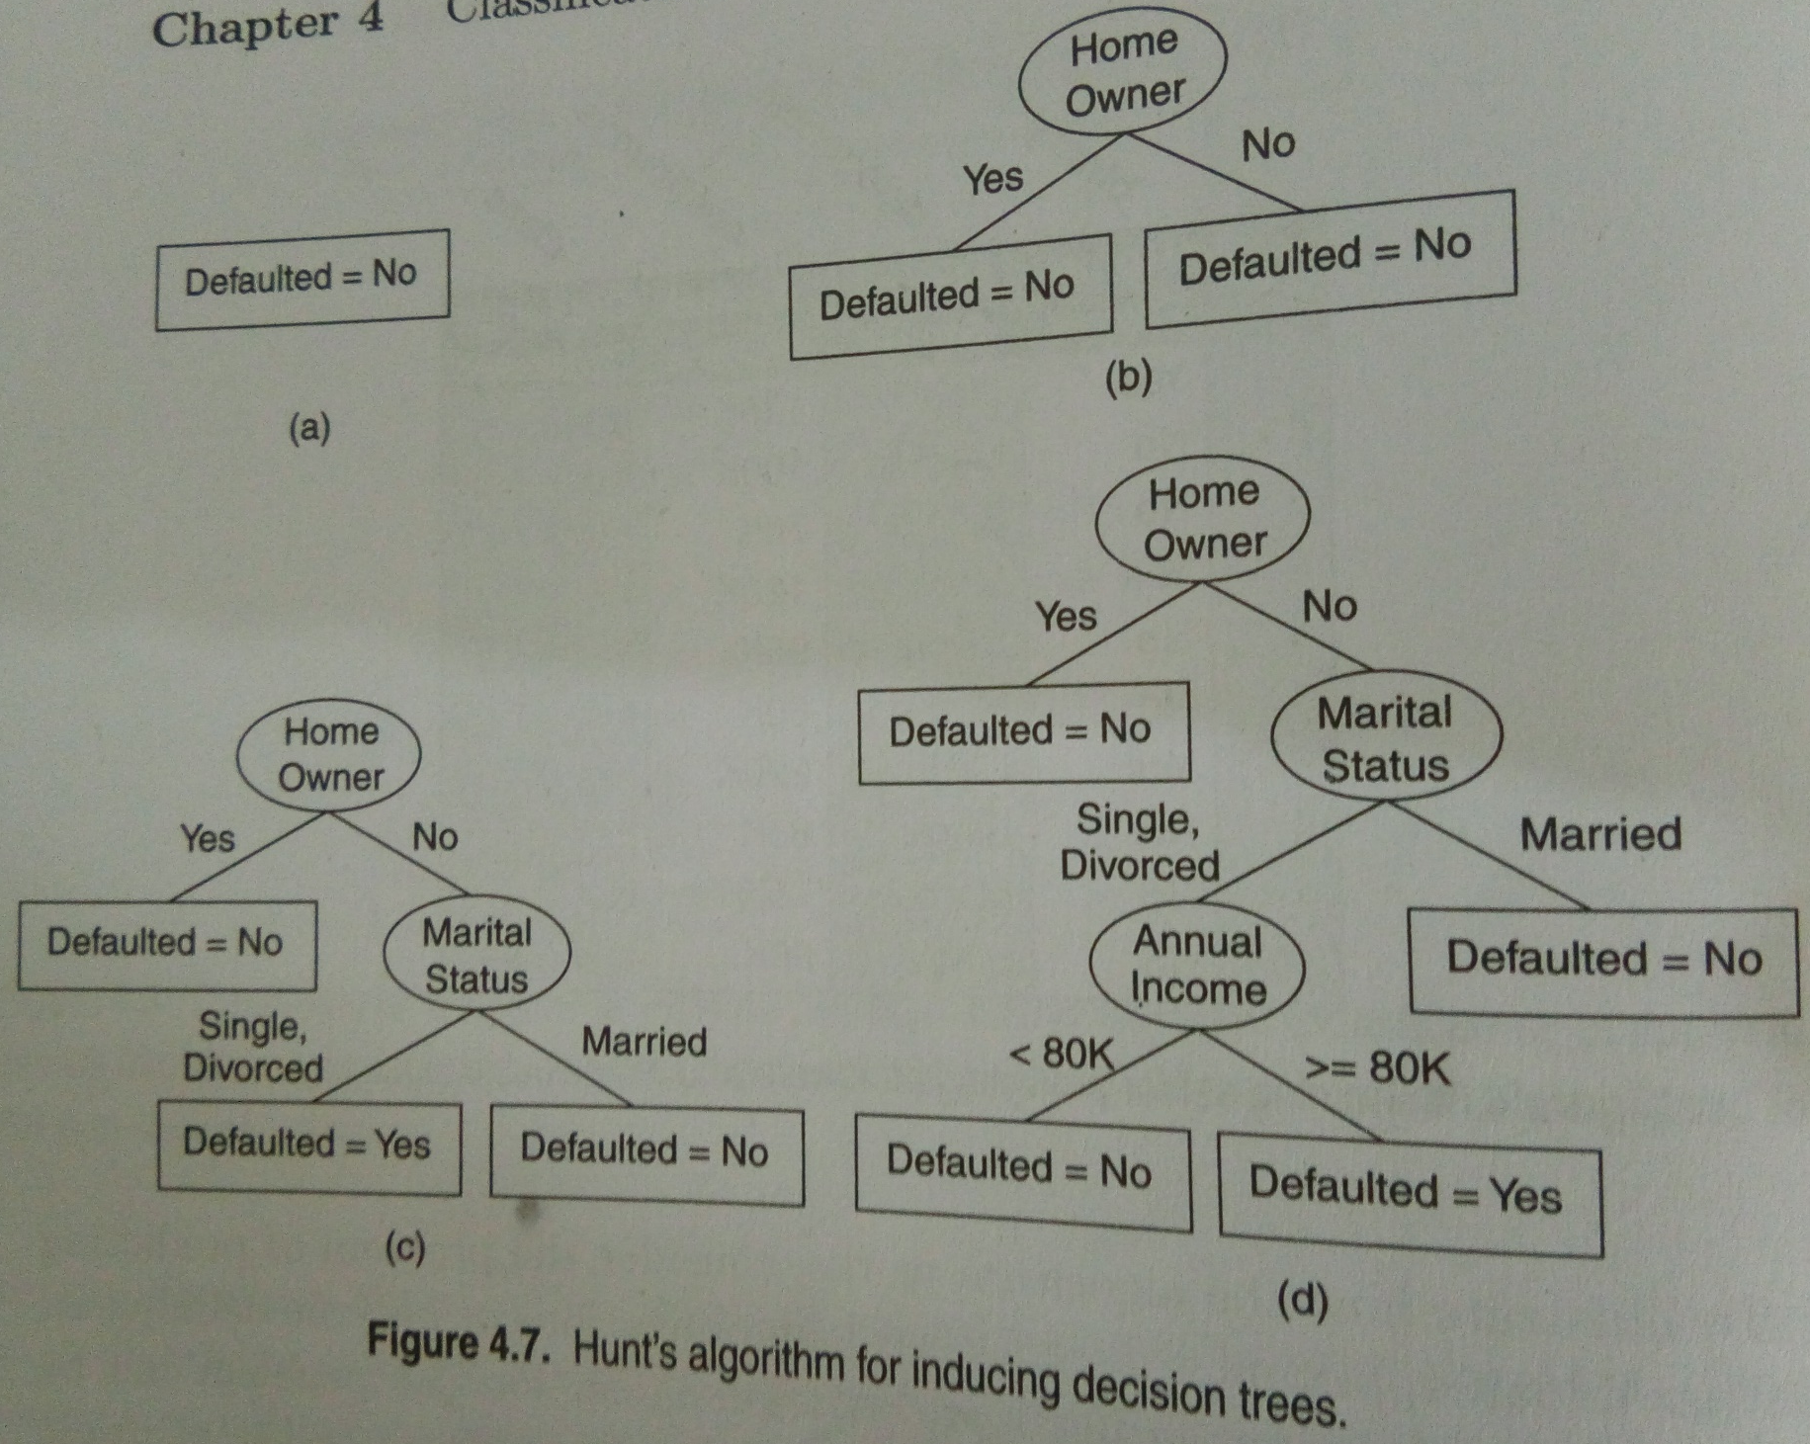
HUNT’S ALGO FOR INDUCING DECISTION TREES

Slide 29
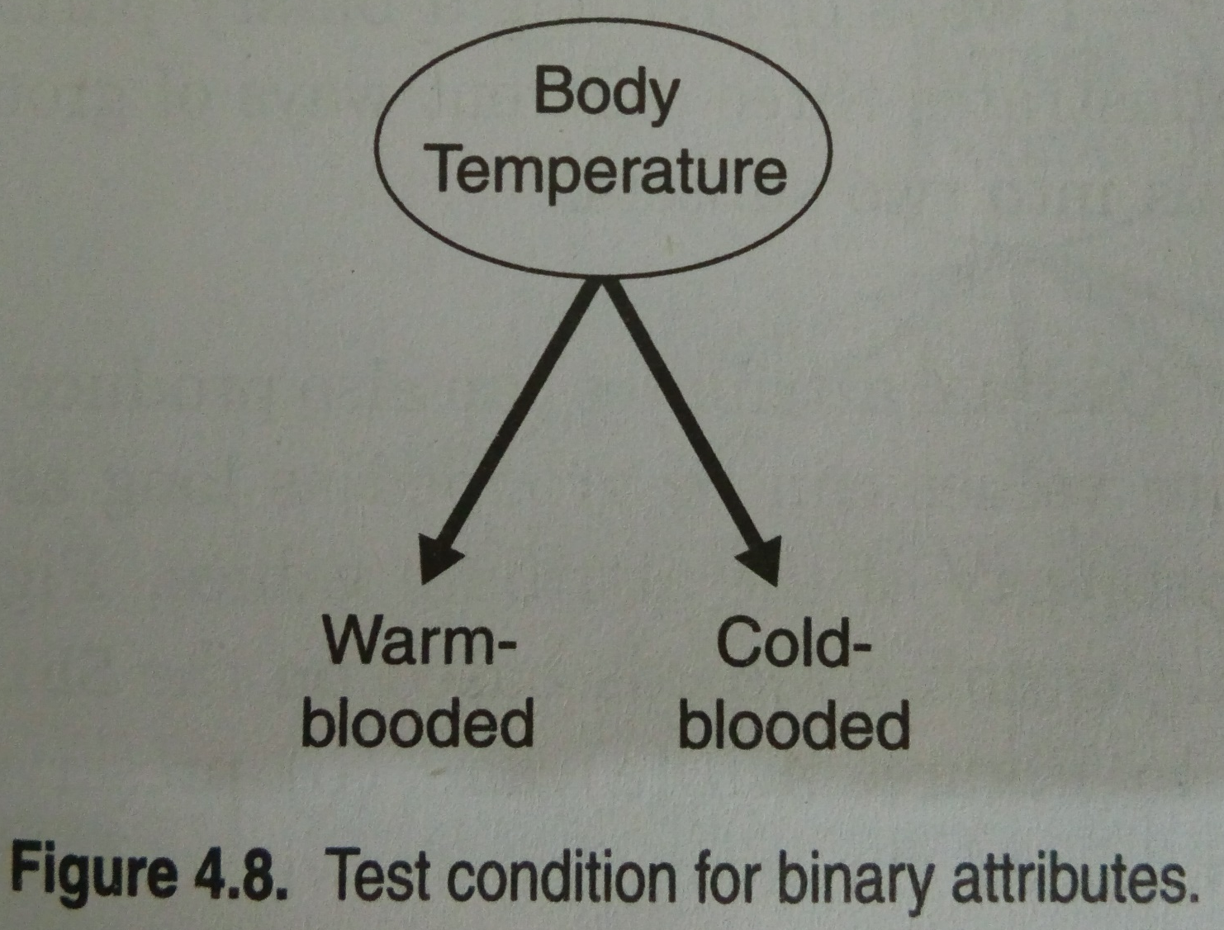

Slide 30
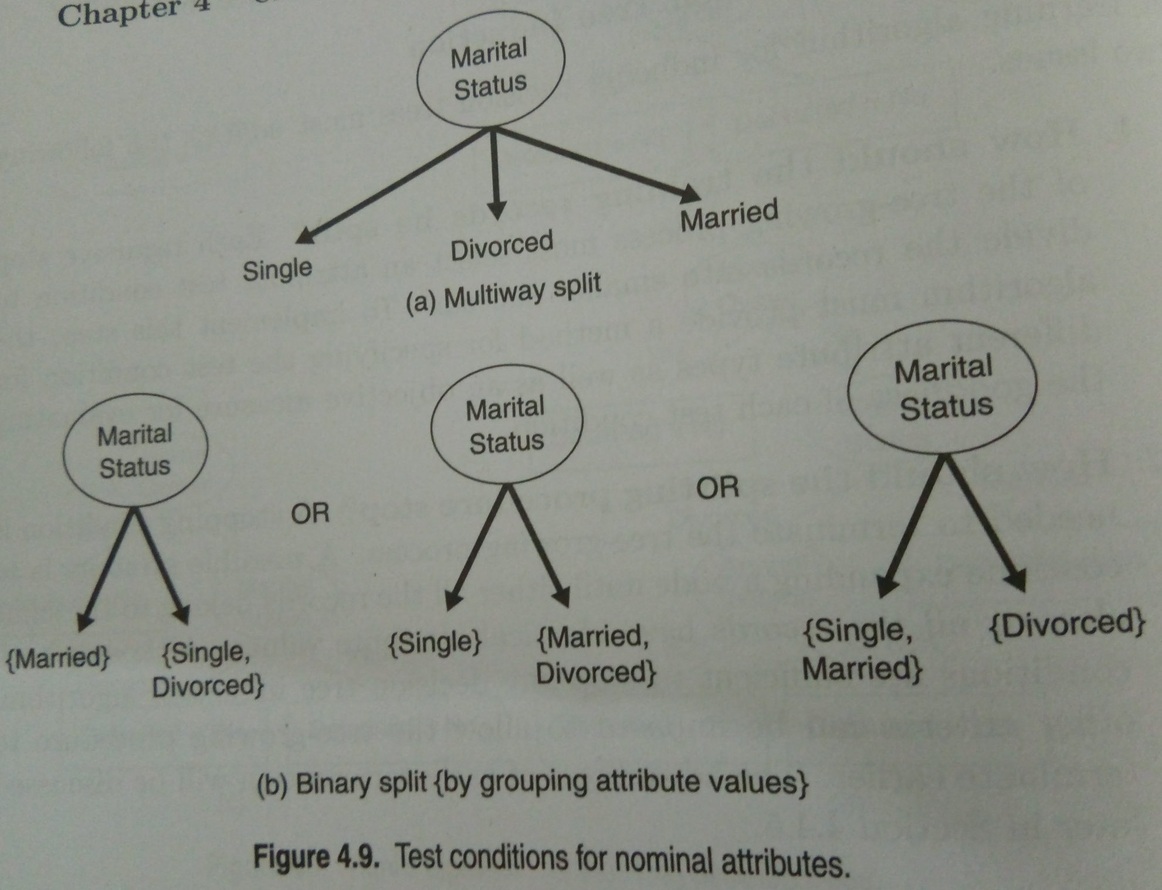

Slide 31
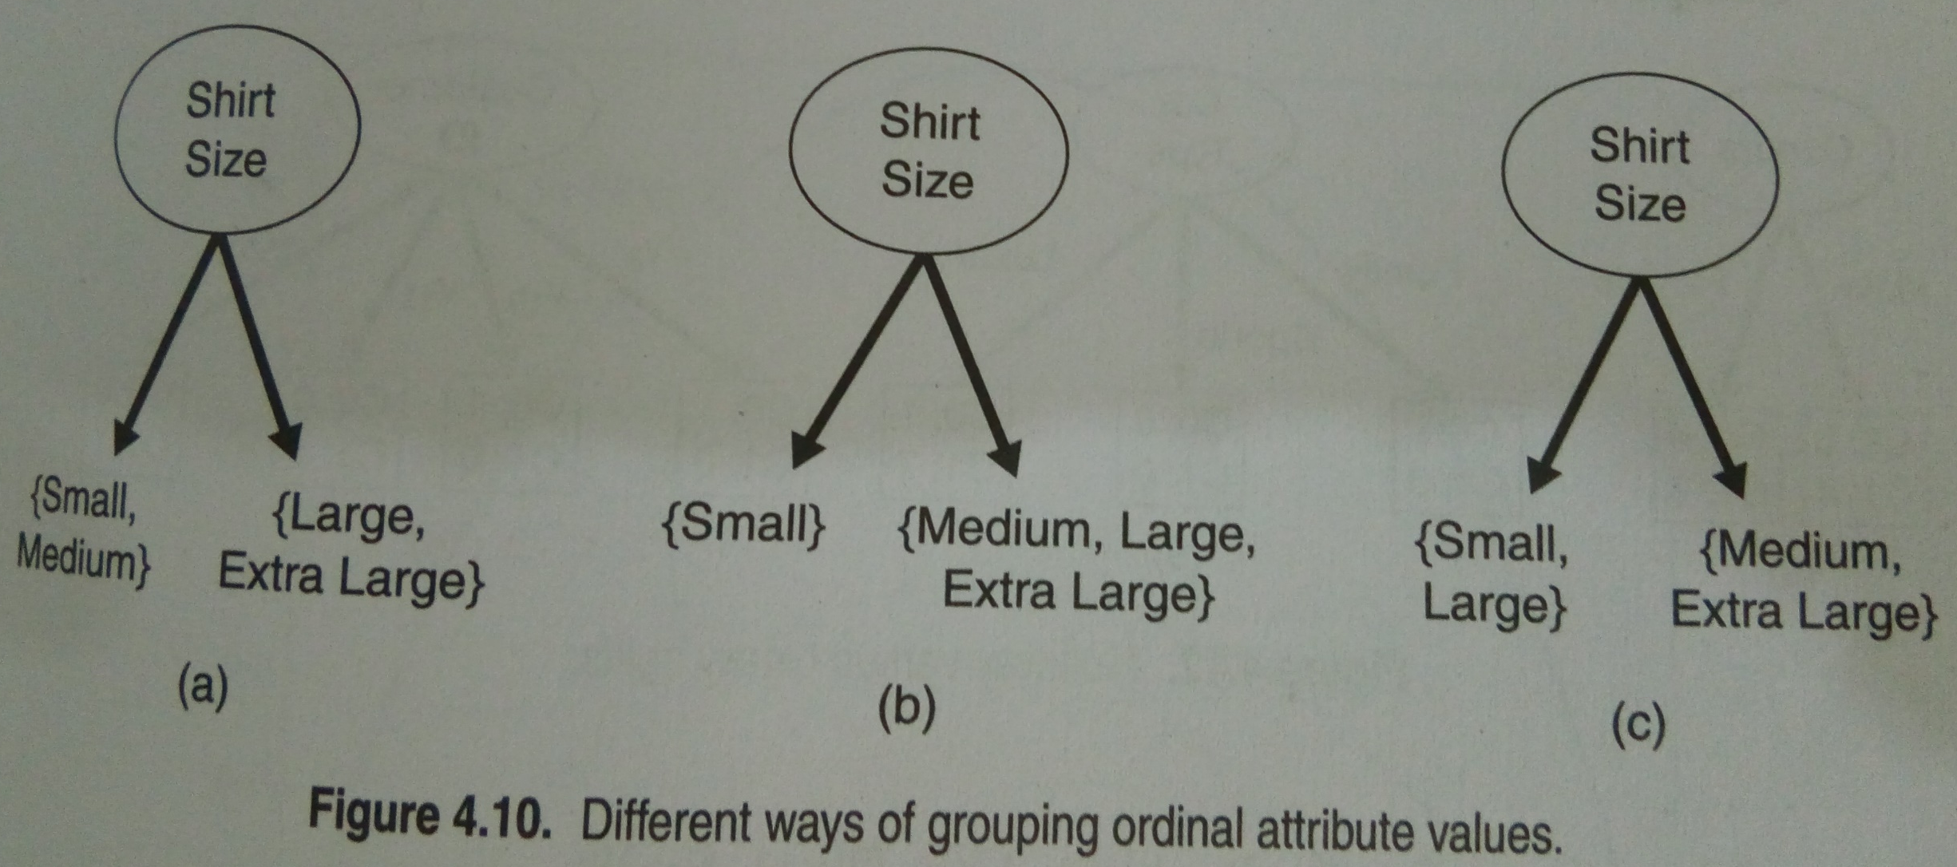

Slide 32
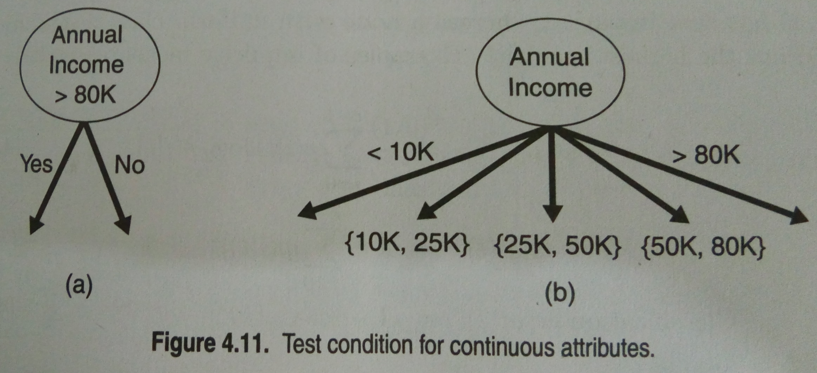

Slide 33
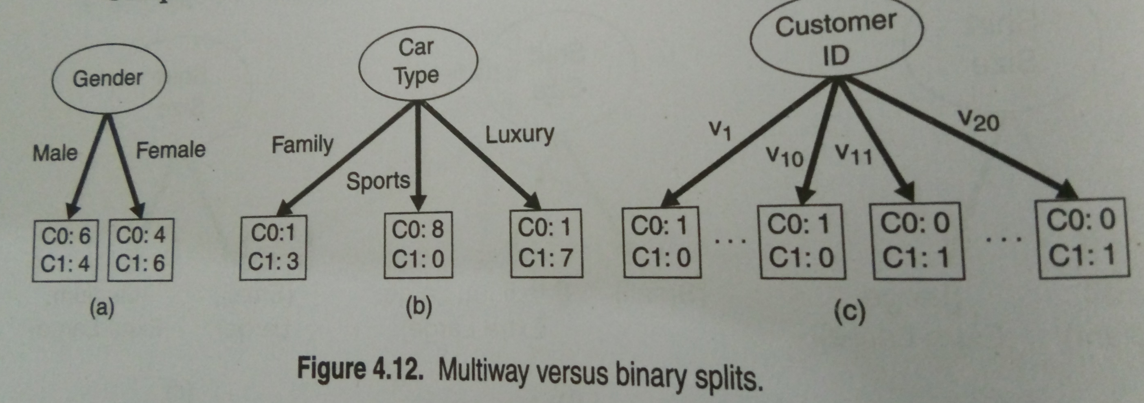

Slide 34
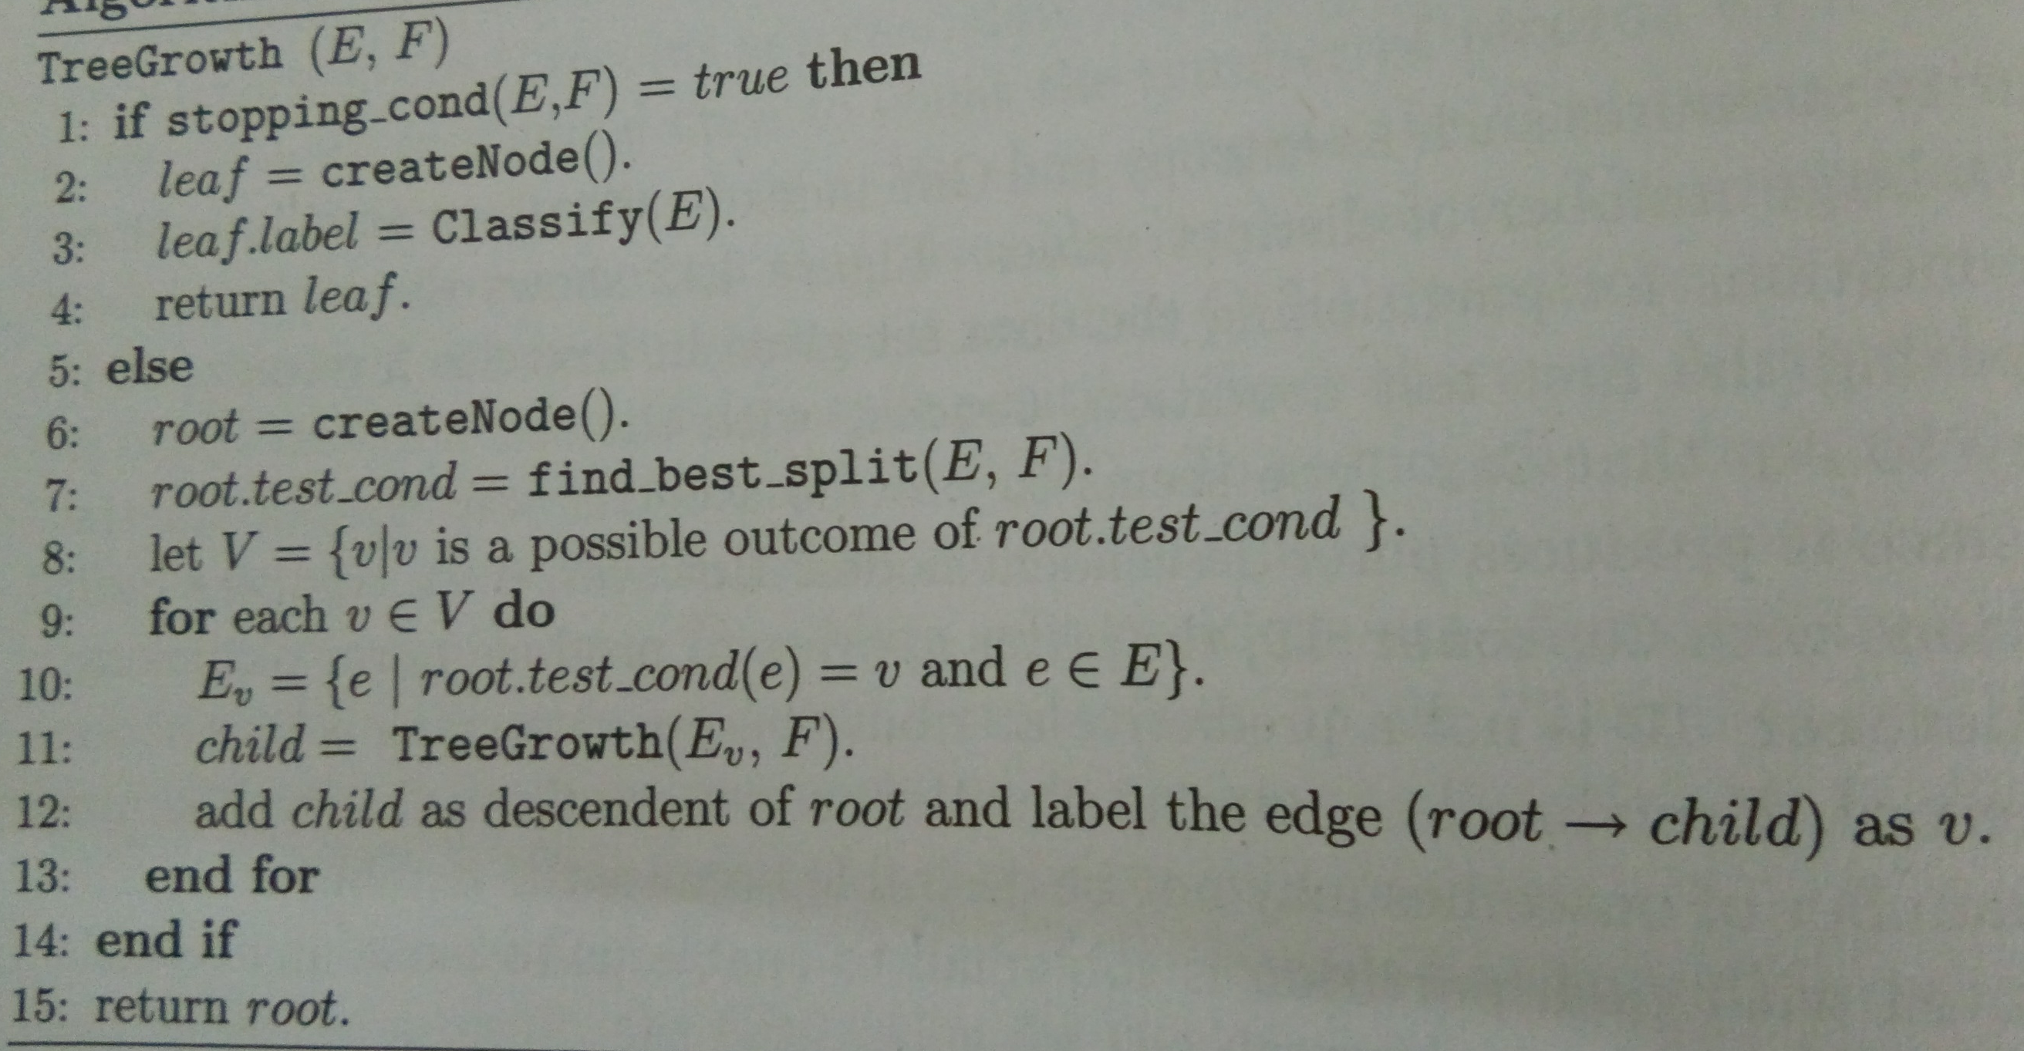
DECISION TREE INDUCTION ALGORITHM

Slide 35
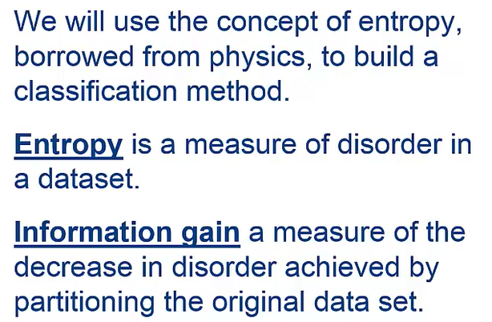

Slide 36
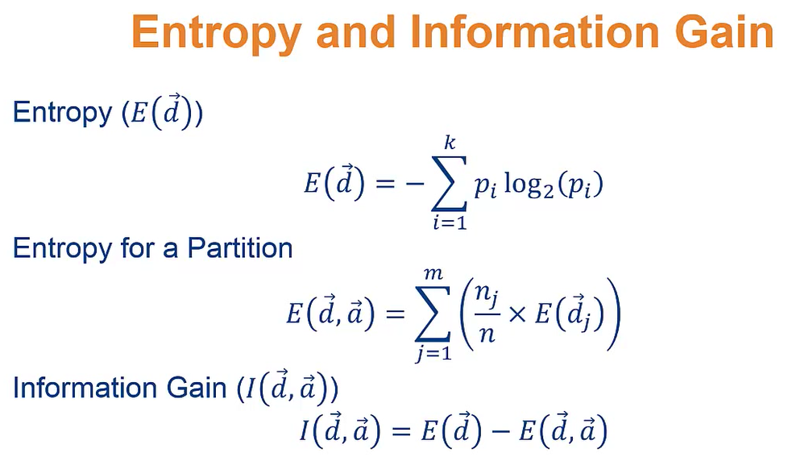

Slide 37
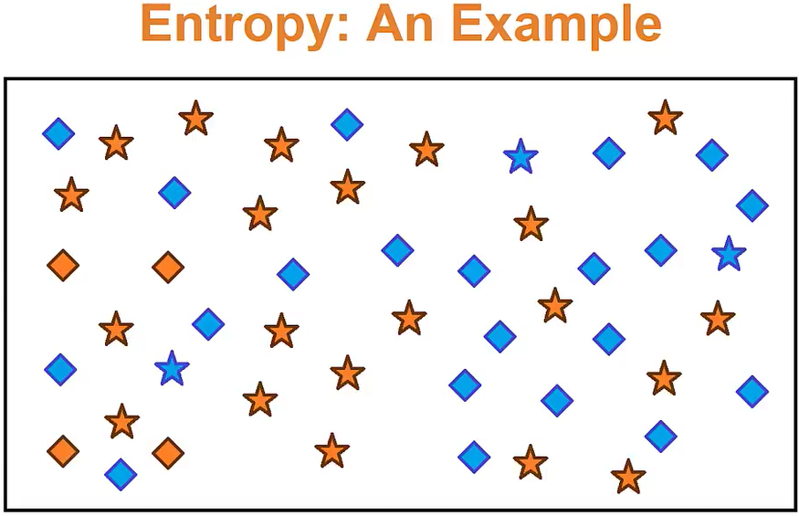

Slide 38
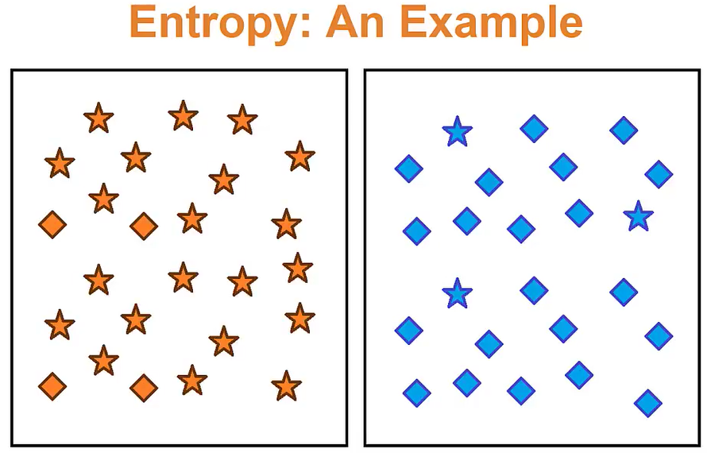

Slide 39
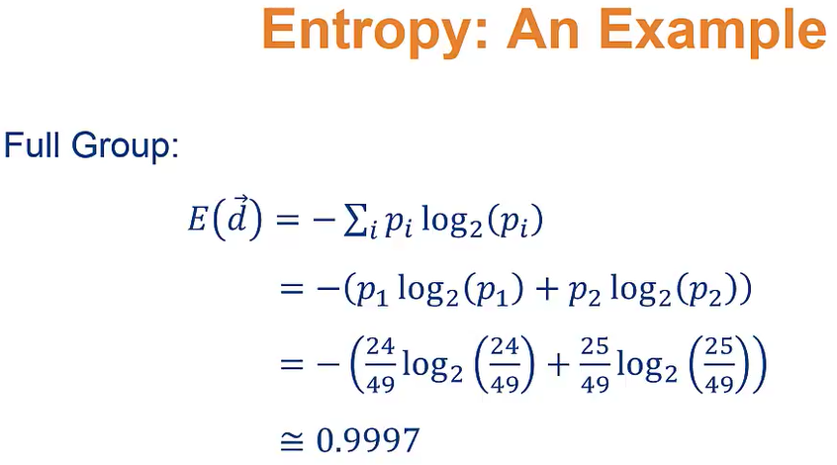

Slide 40
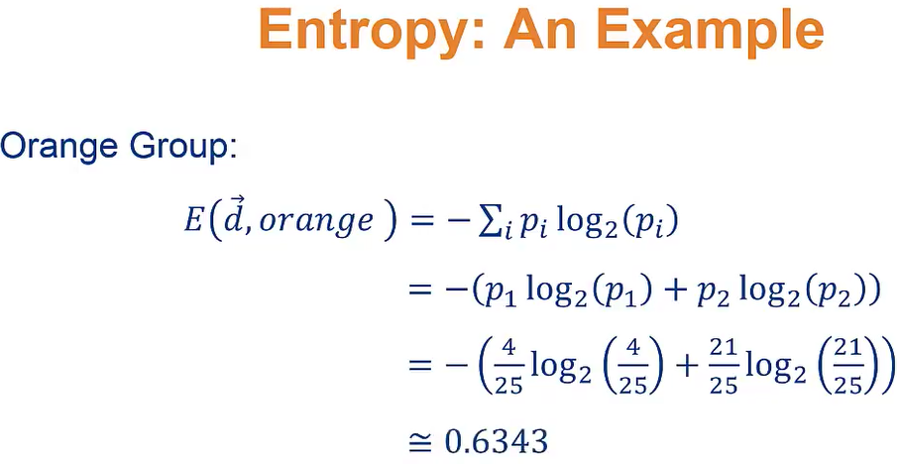

Slide 41
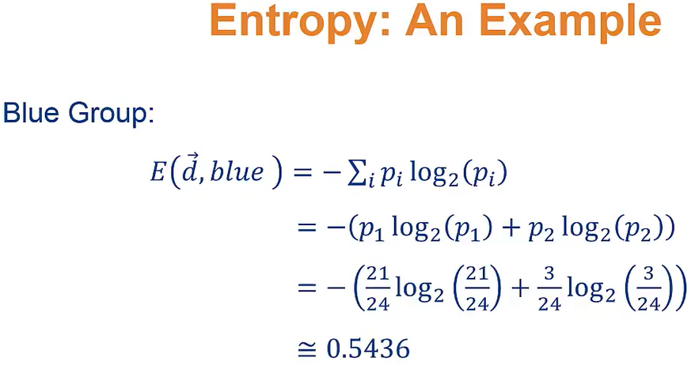

Slide 42
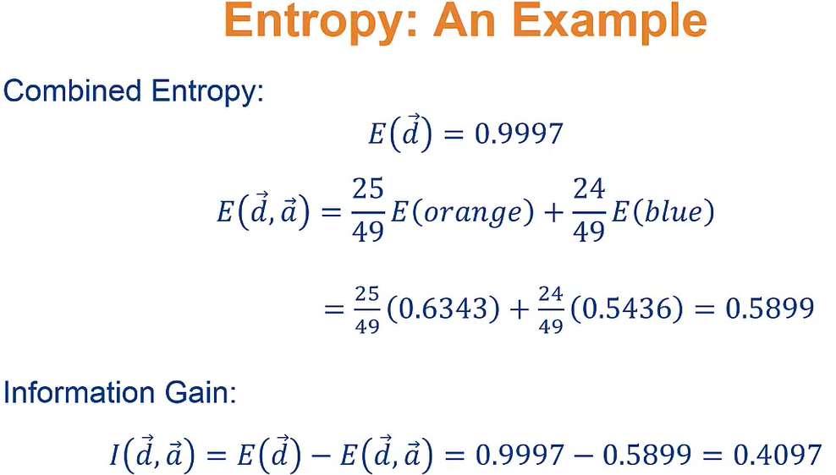

Slide 43
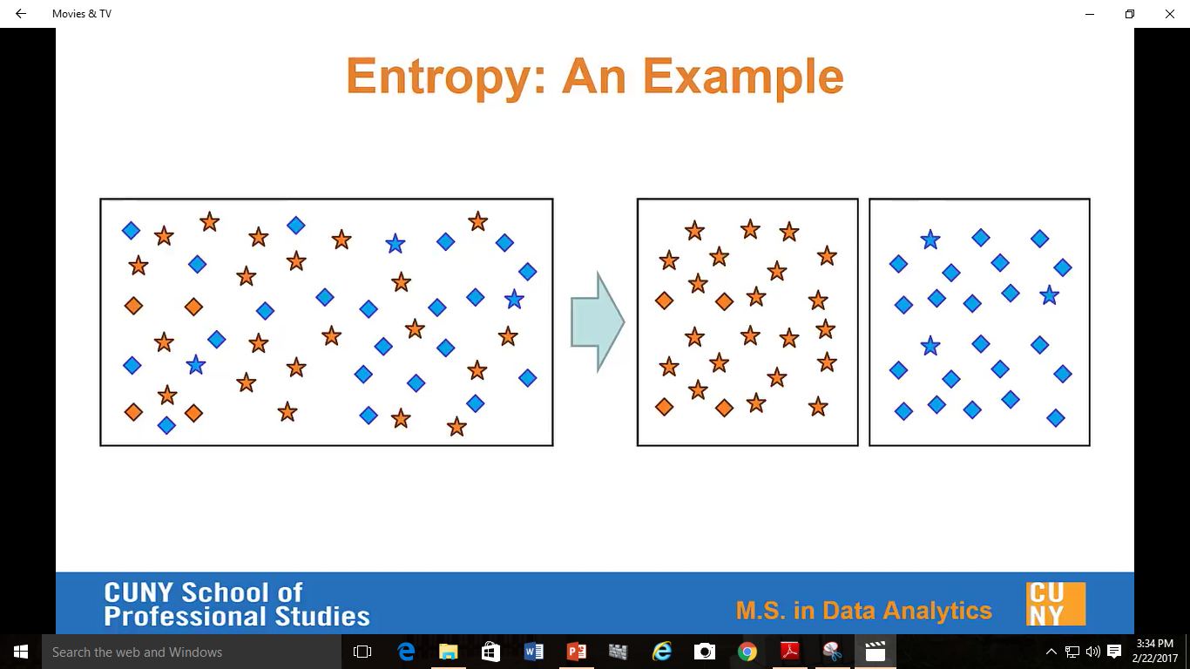

Slide 44
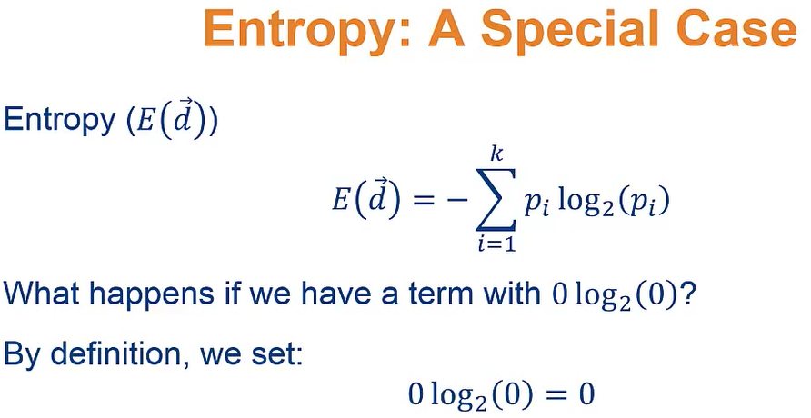

Slide 45
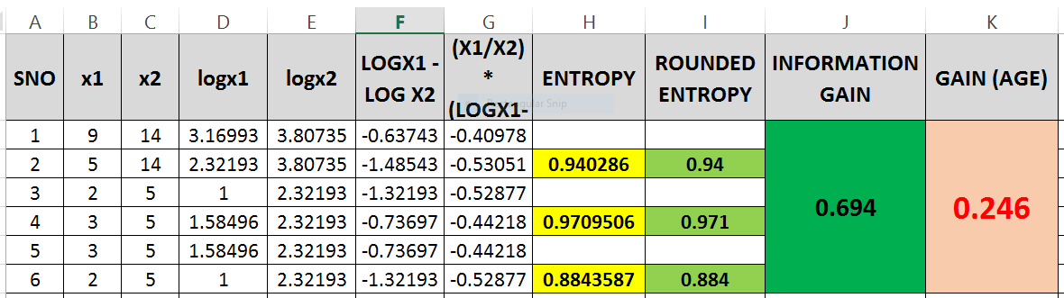

Slide 46
=-(H4/H5) * (I4 - I5)
= (H4/H5) * (LOG(H4,2) - LOG(H5,2))
= (H8/H9) * (LOG(H8,2) - LOG(H9,2))
=-I6 -I10
= (5/14) * (I5) + (5/14) * (l5)
= 2 * ((5/14)*(I5))

Slide 47
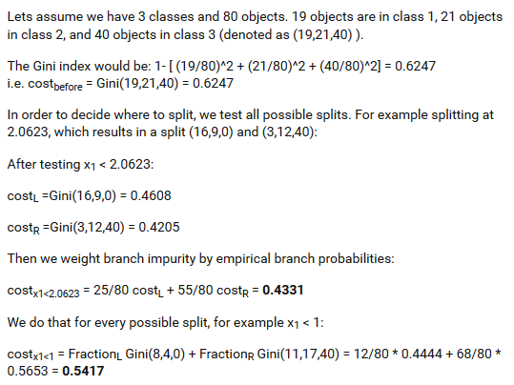

Slide 48
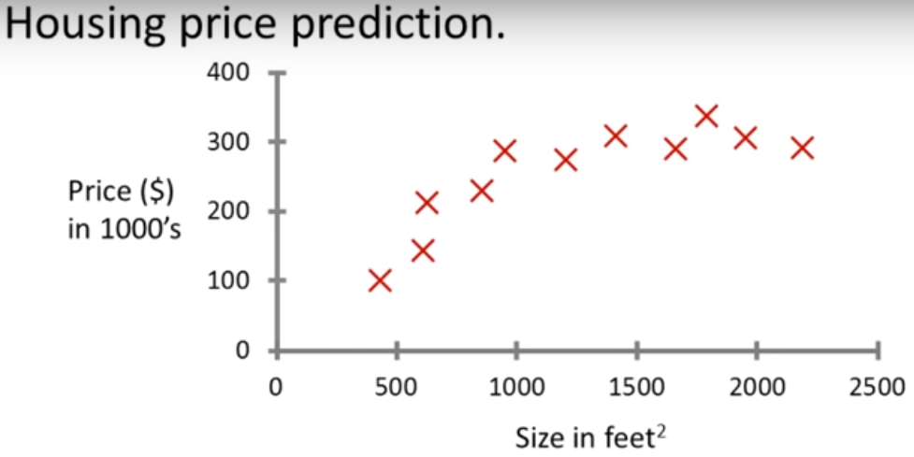

Slide 49
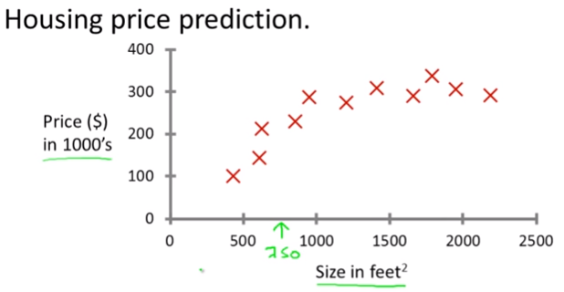

Slide 50
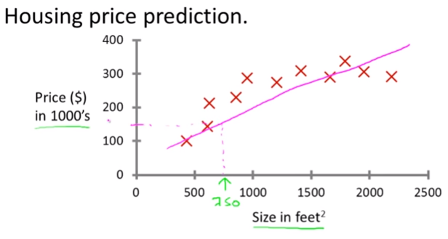

Slide 51
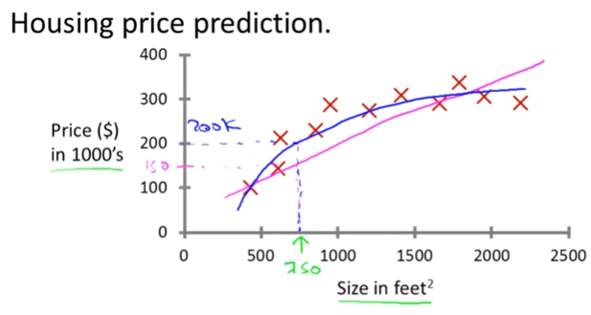

Slide 52
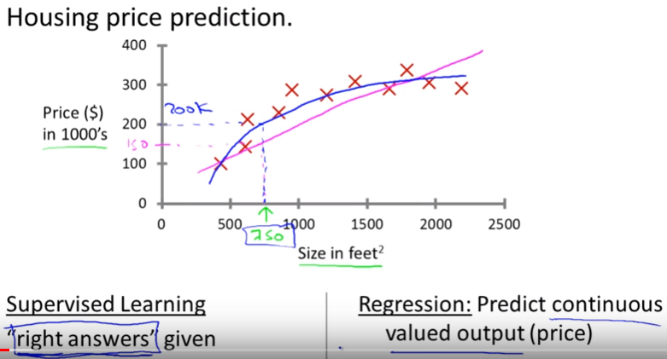

Slide 53
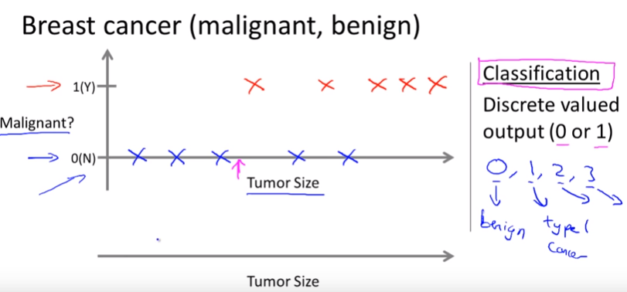

Slide 54
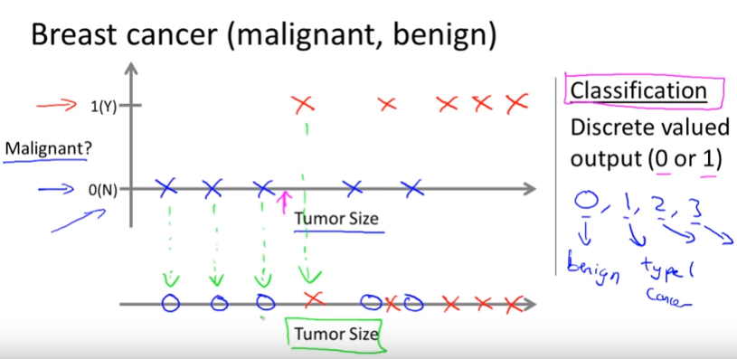

Slide 55
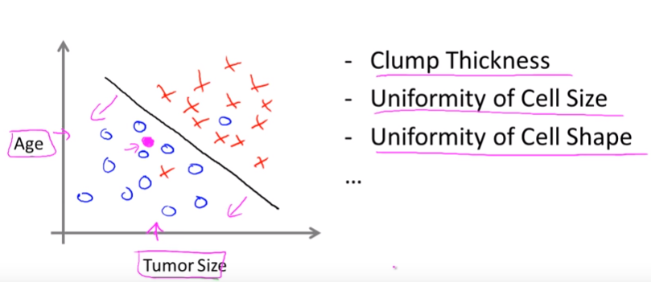

Slide 56
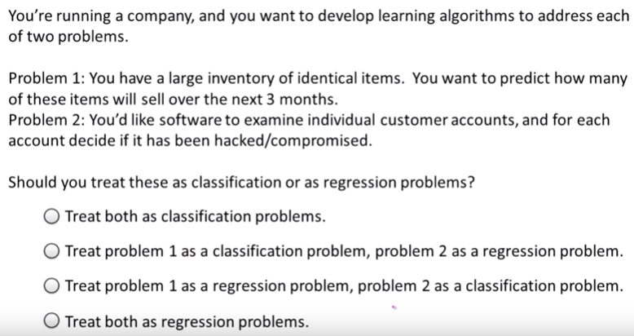

Slide 57
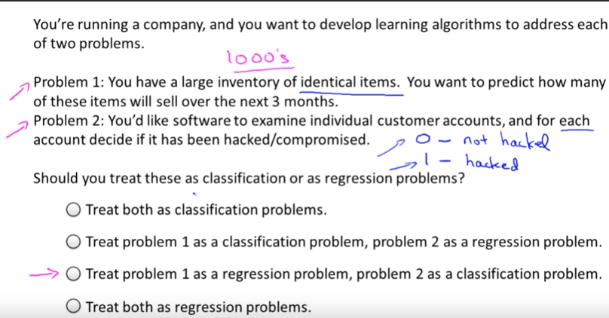

Slide 58
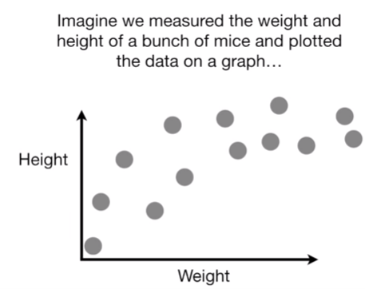
Bias and Variance

Slide 59
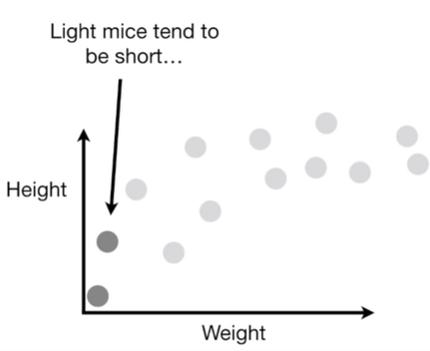
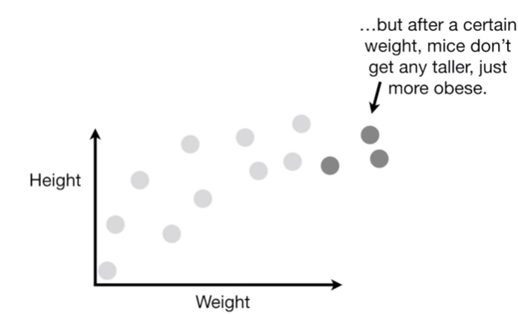

Slide 60



Slide 61



Slide 62



Slide 63



Slide 64



Slide 65



Slide 66



Slide 67



Slide 68


Slide 69


Slide 70


Slide 71


Slide 72


Slide 73


Slide 74


Slide 75


Slide 76


Slide 77


Slide 78


Slide 79


Slide 80


Slide 81


Slide 82


Slide 83


Slide 84


Slide 85


Slide 86


Slide 87



Slide 88


Slide 89


Slide 90


Slide 91


Slide 92


Slide 93


Slide 94


Slide 95


Slide 96


Slide 97


Slide 98


